Slide 1


Robotic Arm BCI
309
8 Credits
10/11/2020
Robotic Arm BCI
‹#›

Slide 2
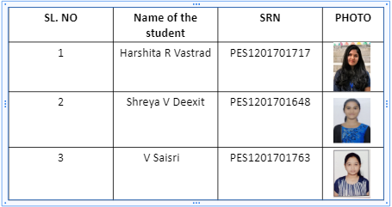
Team composition
10/11/2020
Robotic Arm BCI
‹#›

Slide 3
Contents
SERIAL NO | CONTENT
1 | Feasibility
2 | Work done so far Objective Literature survey Materials and methods Results
3 | Next step
4 | Timeline
5 | References
10/11/2020
Brain-Controlled Robotic Arm using BCI
‹#›

Slide 4
Feasibility
Objectives:
To use brain waves to control robotic arm movement:
Pre-processing the dataset,classifying and sending the classified signal output to robot for arm movement.The outcome of this process is movement of the robotic arm without any motion/gesture in the patients.BCI is used for this purpose.
Image processing for recognition of objects to pick and drop:
This process involves object detection. The robot will be able to detect objects, pick and drop the detected object.
Outcome:
Brain Controlled Robotic Arm System
10/11/2020
Brain-Controlled Robotic Arm using BCI
‹#›

Slide 5
Objective
Apply various pre-processing techniques to the dataset which contributes to the overall performance of the model.
Remove artifacts and unnecessary events(Start of a new trial,Rejected trials,Idling EEG etc) from the dataset.
To identify bad channels.
Extract desirable features from the dataset.
To build a model to classify the pre-processed data.
10/11/2020
Brain-Controlled Robotic Arm using BCI
‹#›

Slide 6
Literature survey
(i) JI-HOON JEONG1, BYEONG-HOO LEE1, DAE-HYEOK LEE1, YONG-DEOK YUN1, AND SEONG-WHAN LEE2,”EEG Classification of Forearm Movement Imagery Using A Hierarchical Flow Convolutional Neural Network”, (FELLOW, IEEE)
DATASET: The dataset contained data acquired from fifteen subjects and acquired the EEG data using 61 channels. The forearm movement classes are also correlated to the forearm rotation angle (0◦, 90 ◦, and 180 ◦)
METHODOLOGY: EEG data were preprocessed by a zero-phase second-order Butterworth bandpass filter with a cutoff frequency from 4 to 40 Hz.To obtain clear EEG data,we removed the contamination factors using an independent component analysis (ICA) .The HF-CNN was trained according to each subject because of the EEG uncertainty characteristics.
RESULT:Classification performance with accuracy of 0.51 (±0.04) for MI task
VOID: We can apply more advanced machine learning algorithms such as the BCI adaptation method and boost artifacts rejections method.
.
10/11/2020
Brain-Controlled Robotic Arm using BCI
‹#›

Slide 7
Literature survey
(ii) Ji-Hoon Jeong , Kyung-Hwan Shim , Dong-Joo Kim , and Seong-Whan Lee, “Brain-Controlled Robotic Arm System Based on Multi-Directional CNN-BiLSTM Network Using EEG Signals”,IEEE Transactions on Neural Systems and Rehabilitation Engineering (Volume: 28 , Issue: 5, May 2020 )
DATASET : BCI Competition IV data set consists of EEG data from 9 subjects. The cue-based BCI paradigm consisted of four different motor imagery tasks(left hand,right hand,both feet,tongue).
METHOD:Removing the contamination factors by an ICA.After spatial filtered, twenty EEG channels near the primary/supplementary motor cortices were selected. The multidirectional CNN-BiLSTM network (MDCBN)-based deep learning framework considering 3D multi-direction was used.
RESULT :The subjects presented a grand averaged success rate of 0.43 (±0.09)
VOID : We can modify the proposed framework to allow training using fewer EEG data samples so that the calibration time required for in real-time BMI control is reduced.
10/11/2020
Robotic Arm BCI
‹#›

Slide 8
Literature survey
(iii) Maryam Mohammadi; Mohammad Reza Mosavi,”Improving the efficiency of an EEG-based brain computer interface using Filter Bank Common Spatial Pattern”,2017 IEEE 4th International Conference on Knowledge-Based Engineering and Innovation (KBEI)
DATASET : Dataset 2a of BCI Competition IV that was presented by Graz University.
METHOD : Signals are filtered using 9 sub-bands: 4-8 Hz, 8-12 Hz, …, 36-40 Hz.Then Spatial Filtering Using Common Spatial Patterns is applied.Classifier used-Naïve Bayesian Classifier
RESULT : The appropriate selection of the processed time segment of each trial, length of sliding window and type of extracted features improve our results They implemented FBCSP along with MI feature selection algorithm and Naive Bayesian classifier.The proposed method has a mean kappa of 0.6.
VOID : The performance of four-class classification on the mentioned dataset can be improved.Should focus on all sections such as preprocessing, feature extraction, feature selection and classification
10/11/2020
Robotic Arm BCI
‹#›
Notes:
https://ieeexplore.ieee.org/document/8324921

Slide 9
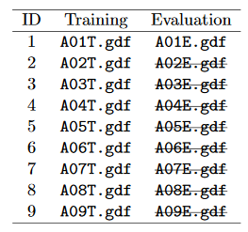
MATERIALS
DATASET :
BCI Competition 2008 – Graz data set A : Contains training and evaluation data. 9 participants . 4 classes. Left hand,Right hand, Feet, Tongue.
22 EEG signals, 3 EOG signals(for eye movements)
Signals were sampled at 250Hz, and bandpass 0.5Hz and 100Hz,The sensitivity of the amplifier was set to 100μV. An additional 50 Hz notch filter was enabled to suppress line noise.
Files are in .gdf format
Files in the dataset:
10/11/2020
Robotic Arm BCI
‹#›

Slide 10
MATERIALS
Jupyter notebook : Python platform used to execute the code.
Mne : Used for exploring ,visualizing and analyzing eeg.
Numpy : Used to store n-dimensional array objects.
Matplotlib : Used for visualizing data.
Pywavelets : Python wavelet transforms module used in wavelet packet decomposition.
Keras : Neural network library for developing and evaluating deep learning models.
ICA : Object used to estimates independent components from mne.io.Raw
Pandas : Data analysis tool used to observe the values of the dataset.
10/11/2020
Robotic Arm BCI
‹#›

Slide 11
METHOD
Extracting the data
Find the events
Bandpass filter
Removing bad channels
Plotting desired epochs
Renaming the labels
10 fold cross validation
Model build
Wavelet packet decomposition
Metrics
10/11/2020
Robotic Arm BCI
‹#›

Slide 12
METHOD
Extracting the data
Find the events
Bandpass filter
Removing bad channels
Plotting desired epochs
Renaming the labels
10 fold cross validation
Model build
Wavelet packet decomposition
Metrics
10/11/2020
Robotic Arm BCI
‹#›

Slide 13
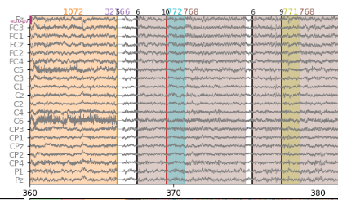
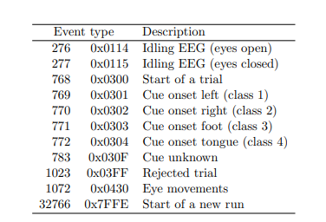
EVENTS
10/11/2020
Robotic Arm BCI
‹#›

Slide 14
METHOD
Extracting the data
Find the events
Bandpass filter
Removing bad channels
Plotting desired epochs
Renaming the labels
10 fold cross validation
Model build
Wavelet packet decomposition
Metrics
10/11/2020
Robotic Arm BCI
‹#›

Slide 15
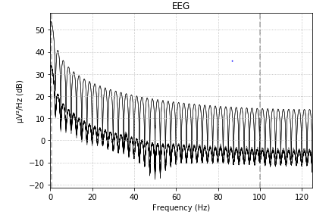
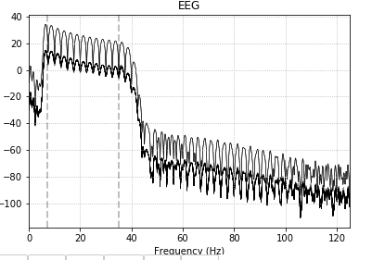
RESULT
Power Spectrum before Band pass filter
Power Spectrum after Band pass Filter Applied
10/11/2020
Robotic Arm BCI
‹#›

Slide 16
METHOD
Extracting the data
Find the events
Bandpass filter
Removing bad channels
Plotting desired epochs
Renaming the labels
10 fold cross validation
Model build
Wavelet packet decomposition
Metrics
10/11/2020
Robotic Arm BCI
‹#›

Slide 17
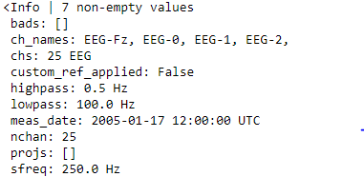
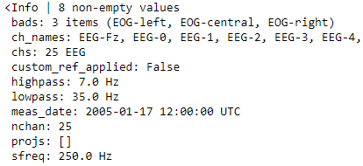
RESULT
10/11/2020
Robotic Arm BCI
‹#›

Slide 18
METHOD
Extracting the data
Find the events
Bandpass filter
Removing bad channels
Plotting desired epochs
Renaming the labels
10 fold cross validation
Model build
Wavelet packet decomposition
Metrics
10/11/2020
Robotic Arm BCI
‹#›

Slide 19
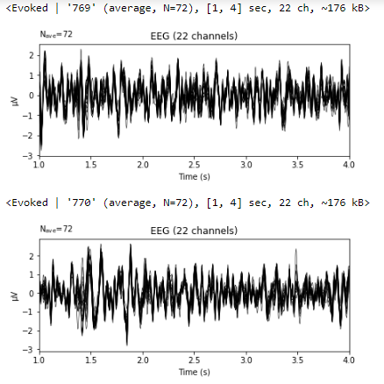
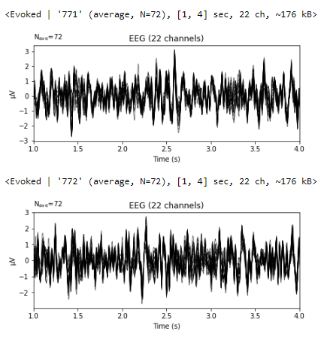
RESULTS
Left hand = 769
Right hand = 770
Foot = 771
Tongue = 772
10/11/2020
Robotic Arm BCI
‹#›
Notes:
Can add screenshots of plotted waveforms
Ica pictures
Accuracy screenshots

Slide 20
METHOD
Extracting the data
Find the events
Bandpass filter
Removing bad channels
Plotting desired epochs
Getting labels and changing labels from 7,8,9,10 -> 1,2,3,4
Renaming the labels
10 fold cross validation
Model build
Wavelet packet decomposition
Metrics
10/11/2020
Robotic Arm BCI
‹#›

Slide 21
METHOD
Extracting the data
Find the events
Bandpass filter
Removing bad channels
Plotting desired epochs
Renaming the labels
Metrics
10 fold cross validation
Model build
Wavelet packet decomposition
Signal is decomposed to level 5 with 'db4' wavelet.db4 is chosen due to their near optimal time frequency localisation properties.
10/11/2020
Robotic Arm BCI
‹#›

Slide 22
METHOD
Extracting the data
Find the events
Bandpass filter
Removing bad channels
Plotting desired epochs
Renaming the labels
Metrics
10 fold cross validation
Model build
Wavelet packet decomposition
8 frequency band coefficients are chosen from the range 4-32Hz
10/11/2020
Robotic Arm BCI
‹#›

Slide 23
METHOD
Extracting the data
Find the events
Bandpass filter
Removing bad channels
Plotting desired epochs
Renaming the labels
10 fold cross validation
Model build
Wavelet packet decomposition
Metrics
10/11/2020
Robotic Arm BCI
‹#›

Slide 24
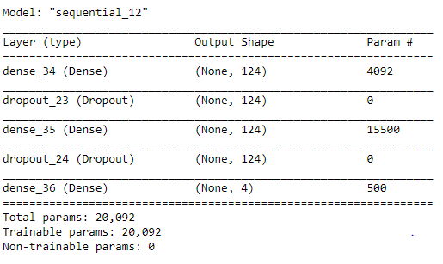
MODEL SUMMARY
Activation Function
Relu
Activation Function
Softmax
Loss = Categorical crossentropy
batch_size = 32, epochs = 300
10/11/2020
Robotic Arm BCI
‹#›

Slide 25
METHOD
Extracting the data
Find the events
Bandpass filter
Removing bad channels
Plotting desired epochs
Renaming the labels
10 fold cross validation
Model build
Wavelet packet decomposition
Metrics
10/11/2020
Robotic Arm BCI
‹#›

Slide 26
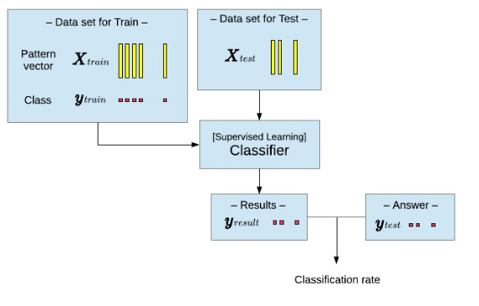
Train Test Split
20%
80%
ANN Model
10/11/2020
Robotic Arm BCI
‹#›

Slide 27
METHOD
Extracting the data
Find the events
Bandpass filter
Removing bad channels
Plotting desired epochs
Renaming the labels
10 fold cross validation
Model build
Wavelet packet decomposition
Metrics
10/11/2020
Robotic Arm BCI
‹#›

Slide 28
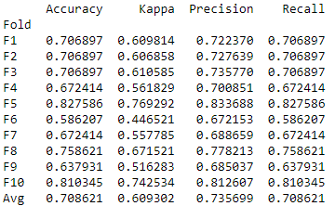
RESULT
10/11/2020
Robotic Arm BCI
‹#›

Slide 29
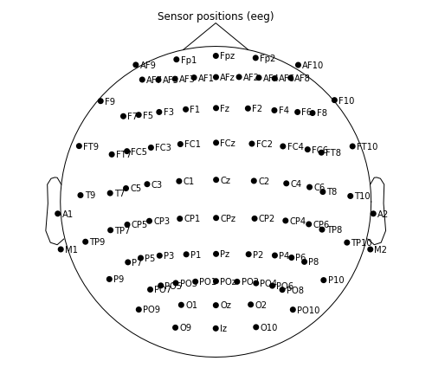
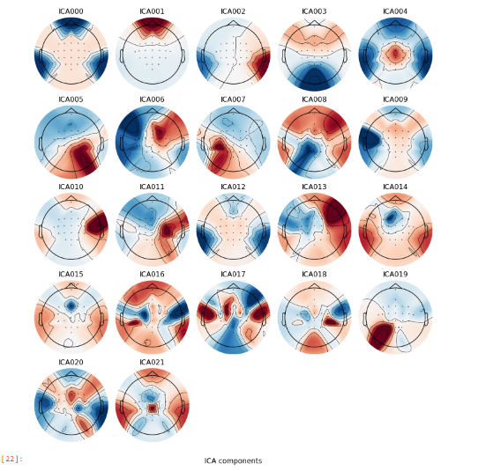
RESULTS
ICA Components:
10/11/2020
Robotic Arm BCI
‹#›

Slide 30
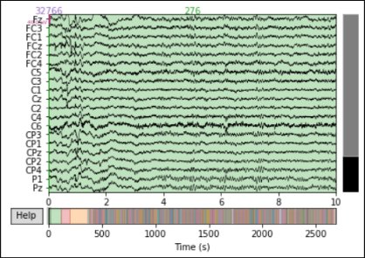
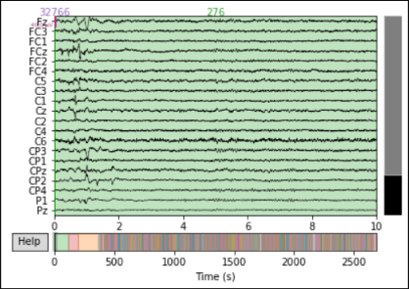
RESULTS
EEG signal before applying ICA
EEG signal after excluding 0 and 1 ICA components
10/11/2020
Robotic Arm BCI
‹#›

Slide 31
NEXT STEP
Fine tuning the model and applying different pre-processed data to the algorithm.
Trying out different algorithms and compare.
Finalysing the model which has the best accuracy.
10/11/2020
Robotic Arm BCI
‹#›

Slide 32
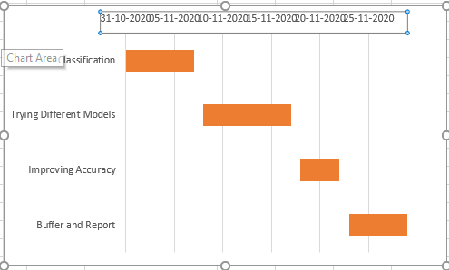
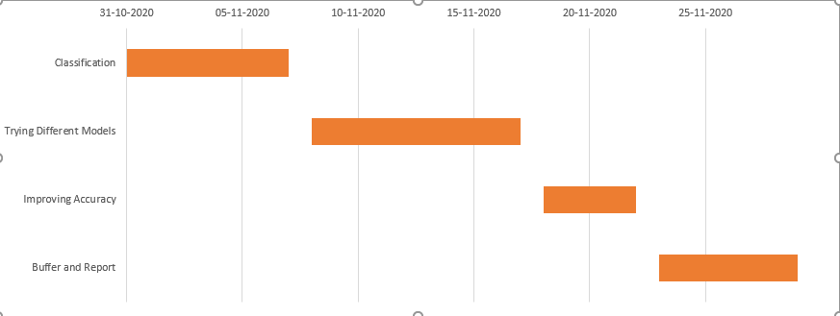
TIMELINE
10/11/2020
Robotic Arm BCI
‹#›

Slide 33
REFERENCES
JI-HOON JEONG1, BYEONG-HOO LEE1, DAE-HYEOK LEE1, YONG-DEOK YUN1, AND SEONG-WHAN LEE2,”EEG Classification of Forearm Movement Imagery Using A Hierarchical Flow Convolutional Neural Network”, (FELLOW, IEEE)
Ji-Hoon Jeong , Kyung-Hwan Shim , Dong-Joo Kim , and Seong-Whan Lee, “Brain-Controlled Robotic Arm System Based on Multi-Directional CNN-BiLSTM Network Using EEG Signals”,IEEE Transactions on Neural Systems and Rehabilitation Engineering (Volume: 28 , Issue: 5, May 2020 )
Maryam Mohammadi; Mohammad Reza Mosavi,”Improving the efficiency of an EEG-based brain computer interface using Filter Bank Common Spatial Pattern”,2017 IEEE 4th International Conference on Knowledge-Based Engineering and Innovation (KBEI)
MNE Documentation : https://mne.tools/stable/overview/index.html
Pywavelets Documentation : https://pypi.org/project/PyWavelets/#:~:text=PyWavelets%20is%20a%20Python%20wavelet,Wavelet%20Packet%20decomposition%20and%20reconstruction
ICA module : https://mne.tools/stable/generated/mne.preprocessing.ICA.html?mne.preprocessing.ICA.find_bads_eog
10/11/2020
Robotic Arm BCI
‹#›

Slide 34
Thank You…
10/11/2020
Robotic Arm BCI
‹#›

